Slide 1


CMR TECHNICAL CAMPUS UGC AUTONOMOUS Accredited by NBA & NAAC with ‘A’ Grade Approved by AICTE, New Delhi and JNTU, Hyderabad Kandlakoya(V), Medchal Road, Hyderabad-501401, Telangana Department of Computer Science and Engineering (Data Science) Deep Cross-modal Face Naming for People News Retrieval
BATCH NO : 11
Mohammad Rajamiya 217R1A67A2
Keshav Vyas 217R1A6793
Thumma Mavith Kumar 217R1A67C2
Under the Guidance of
DR.B. Mohan Babu
(Associate Professor)

Slide 2
Abstract
Introduction
Existing system
Drawbacks of existing system
Proposed system
Advantages of proposed system
Architecture
Hardware and software requirements
References
CONTENTS

Slide 3
ABSTRACT
A popular yet difficult subject is how can we incorporate multimodal data sources for face recognizing in news. This work develops a revolutionary deep cross modal face naming technique to enable more efficient people news retrieval for widespread multi-modal news. The effective naming technique in this scheme intends to group the deep features of various modalities into a shared space to investigate their inter-related correlations, and a unique Web mining technique is proposed to optimize the face name matching for uncommon noncelebrity. This method incorporates deep multimodal analysis, cross modal correlation learning, and multimodal information mining. A cross modal face naming model can be modelled using a bi-media concept mapping issue with an inter-related correlation distribution across deep representations of multimodal news. This model's primary purpose is to improve cross modal Name-face correlation and the degree to which they are associated.

Slide 4
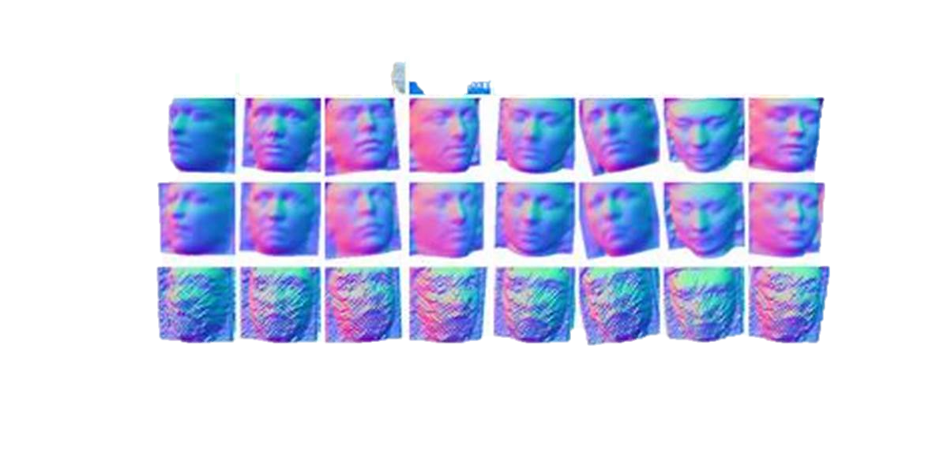
INTRODUCTION
As multimodal news is produced at an exponential rate, retrieval user needs to find multimodal news that is relevant to a particular individual are expanding. A piece of multimodal news is typically presented as a single news photograph with a description that mostly tells the tales of the people in the image. Text matching is a common way to search the news for stories on a specific person. In other words, the target news is the news that meets the query phrase, and to correspond with the terms in news captions, the person's name is utilized as a query keyword. A straight forward textual matching technique, meanwhile, is quite likely to produce inaccurate findings since there might be a great deal of uncertainty regarding the links between the text words such as names in news captions and the visual data As a result, a popular area of research has been how to combine multimodal information source to produce more accurate people caption retrieval. In recent years, face naming has developed as a major approach for autonomously annotating face photographs for more precise and efficient multimodal news or caption retrieval. Face naming may learn the relationships between human names in multimodal news and face images.

Slide 5
EXISTING SYSTEM
The existing system relies solely on text-based queries for news retrieval, limiting its ability to handle multimedia content like images or facial recognition.
It lacks cross-modal learning, meaning it does not integrate text and images to enhance search results.
Current systems do not support name-face matching, making it difficult to retrieve news about rare or non-celebrity individuals.
These systems primarily focus on text datasets, overlooking the potential of image-caption datasets for more accurate results
The static keyword-based matching mechanism restricts users to text queries, offering no flexibility to search using images or faces.

Slide 6
Disadvantages of Existing System
Limited to Text Queries
No Cross-Modal Integration
Inefficient Name-Face Matching
Inflexible Search Mechanism
Poor Multimedia Content Handling

Slide 7
Proposed system
The proposed system integrates deep cross-modal learning to link images, facial features, names, and captions for more accurate and flexible news retrieval.
It allows users to search for news using both image uploads and text queries, making it possible to retrieve related captions and images from multiple modalities.
By training on a dataset that associates names, faces, and captions, the system can effectively match faces to names, even for less-known individuals.
The system enables bi-media semantic mapping, where both images and text are processed together to explore their inter-related correlations.
Unlike the existing system, the proposed approach improves the retrieval of relevant content by supporting face-name correlation and handling complex multimodal queries.

Slide 8
Advantages of proposed system
Multimodal Search Capability
Improved Face-Name Matching
Cross-Modal Correlation
Bi-Media Semantic Mapping
Enhanced Dataset Utilization
Flexible Query Options

Slide 9

Requirements specification
Hardware requirements :
System : Windows
Processor : Intel Core i3 or higher
Hard disk : 40 GB
RAM : 512MB or higher
Software requirements :
Operating System : Windows 10 or 11
Coding Language : Python
Libraries : Pandas,Scikit-learn,Matplotlib,Seaborn
Visualization Tools : Matplotlib,Seaborn

Slide 10
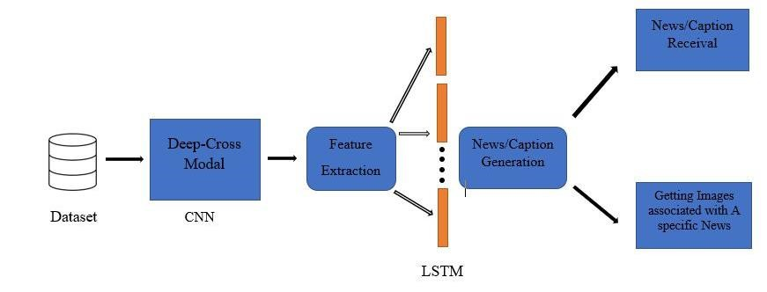
ARCHITECTURE

Slide 11
Conclusion
To take advantage of multimodal face name correlations for better people news retrieval, A scheme for cross modal correlation learning is developed. an unique deep cross modal face naming technique model is developed. Deep multimodal Analysis is performed to determine multimodal news, names and faces have deep representations. To accurately characterize multimodal name-face relationships, A scheme for cross modal correlation learning is developed. For address the dearth of pertinent data for uncommon noncelebrities, an effective mining approach is developed.

Slide 12
References
Shijie Xiao, Dong Xu, Jianxin Wu “An Automatic Face Naming by Learning Discriminative Affinity Matrices from Weakly Labelled Images” IEEE Transaction Neural Network System, October 2015
Guangyu Gao, Mengdi Xu, jialie shen, Huadong Ma “A cast2face assigning character names onto faces in movies with auto character correspondence” IEEE Transaction on circuits VOL. 26 Issue 12, 2016
Pragya Baluni, YP Raiwani Shashi Kant Verma “Automatic Face Naming Using Image Processing A Review Study Based on Face Name Detection in images or videos” Communication in Computer and information Science, July 2017
Samadhi Wickrama Arachchilage, Ebroul Izquierdo “A Framework for Real-Time Face recognition” IEEE Visual Communication and image Processing ISSN 2642-9357, December 2019
by jianxin Sun, Qi li, Weining Wang Jian Zhao, Zhenan sun “A Multi-caption Text-to-Face Synthesis: Dataset and Algorithm” October 2021
Zhenguo Yuan, Chen Long, Lan Fu “Face detection and recognition Based on visual attention Mechanism Guidance Model in Unrestricted Posture” VOL. 2020 May 2020
Chenliang Li, Aixin Sun, Jianshu weng and Qi He “Tweet Segmentation and Its Application to Named Entity Recognition” IEEE Transaction on Knowledge and data Engineering VOL. 27 Issue 2 , 2015
Yongtao Hu, Jimmy SJ. Ren, Jingwen Dai, Chang Yuan, Li Xu, Wenping Wang “ A Deep Multi-modal Speaker Naming “ July 2015
Xin Liu, Jiajia Geng, Haibin Ling “Efficient Speaker Naming via Deep Audio-Face Fusion and End-to-End Attention Model” IEEE (ACPR) , 2017
Kaipeng Zhang, Zhanpeng Zhang, Zhifeng Li, Yu Qiao “Joint Face Detection and Alignment Using Multitask
Cascaded Convolutional Networks” IEEE Signal Processing Letters VOL. 23 April 2016

Slide 13


